Slide 1
Tools for Targeted Sequencing and NGS analysis
O. Harismendy, PhD
BIOM262 – W2016

Slide 2
Multi-Step analysis
Quality Control
Read Alignment
Alignment Refinement
Variant Calling
Variant Annotation
Visualization
Alignment
Variants

Slide 3
Alignment and Variant Calling Pipeline
Process from HiSeq
Align
Refine
Call Variants
HiSeq BCL files
FASTQ format
Mapped BAM
Cleaned BAM
BWA
Align
GATK
Realign
GATK
Call
Left Align Indels
Filter
Evaluate
CASAVA 1.8
Sort
Reformat
-Unmapped
Samtools
Picard
-Duplicates
GATK
Recalibrate
FASTQ format
Mapped BAM
Cleaned BAM
Filtered VCF

Slide 4
File Sizes
 | Depth | FASTQ.gz | BAM | VCF.gz
Genome | 30x | 100-200Gb | 100-200Gb | 2Gb
Exome (50 Mb) | 120x | 5-10 Gb | 10-30Gb | 3-6Mb
Deep Targeted (150 kb) | 1500x | 300-500Mb | 150Mb | 3-6Mb
Assume 100 bp read length

Slide 5
Instrument QC

Slide 6
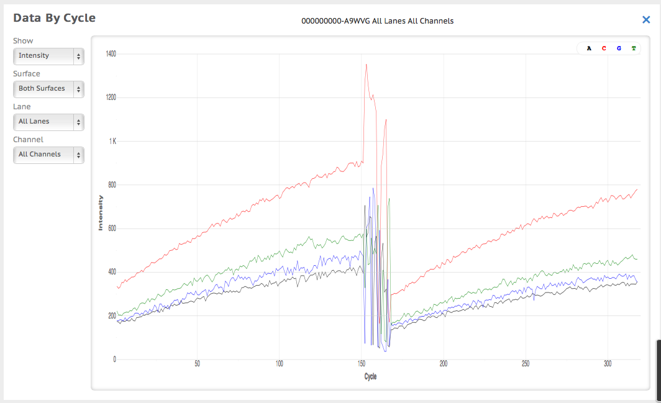
Instrument QC

Slide 7
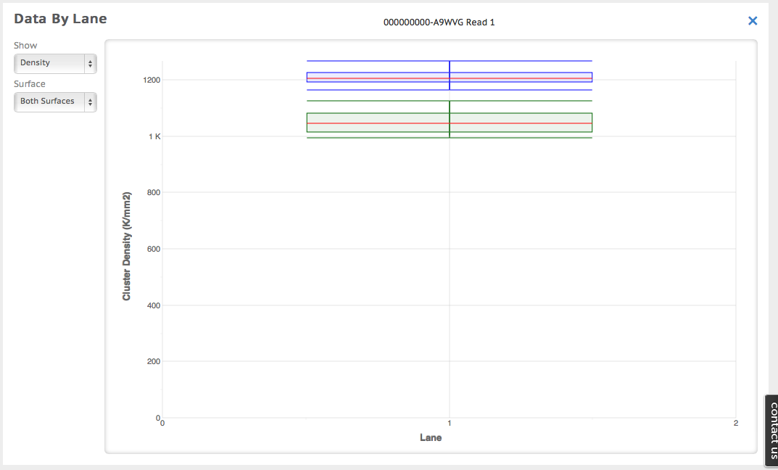
Instrument QC

Slide 8
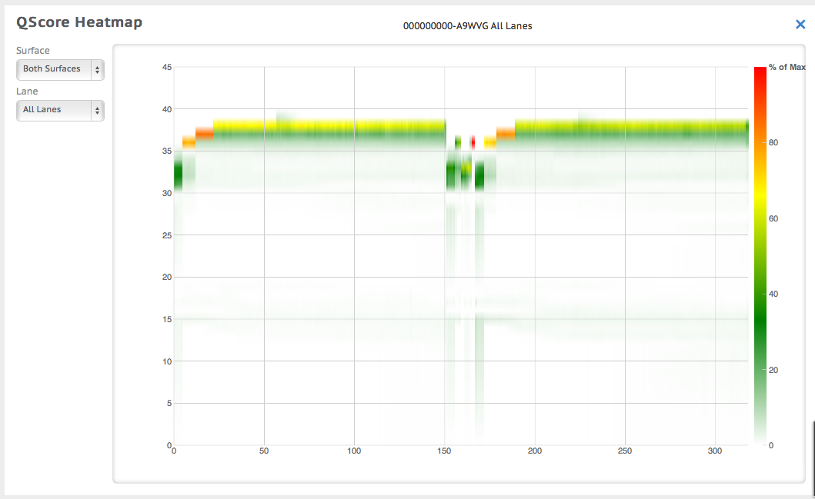
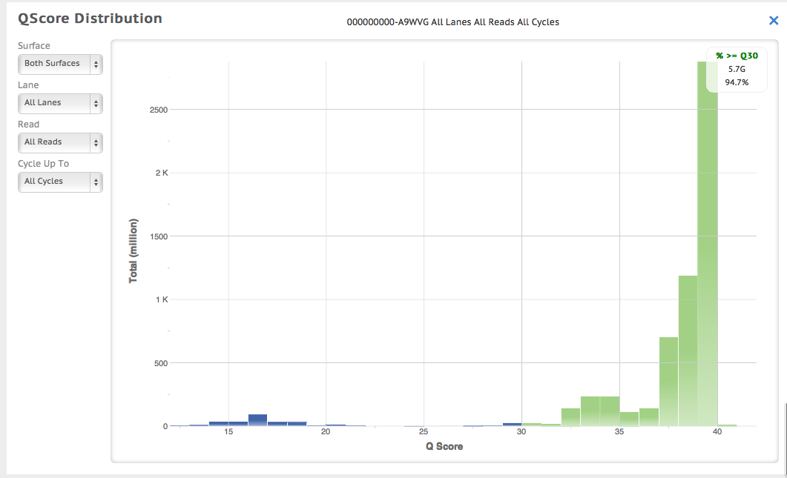
Instrument QC

Slide 9
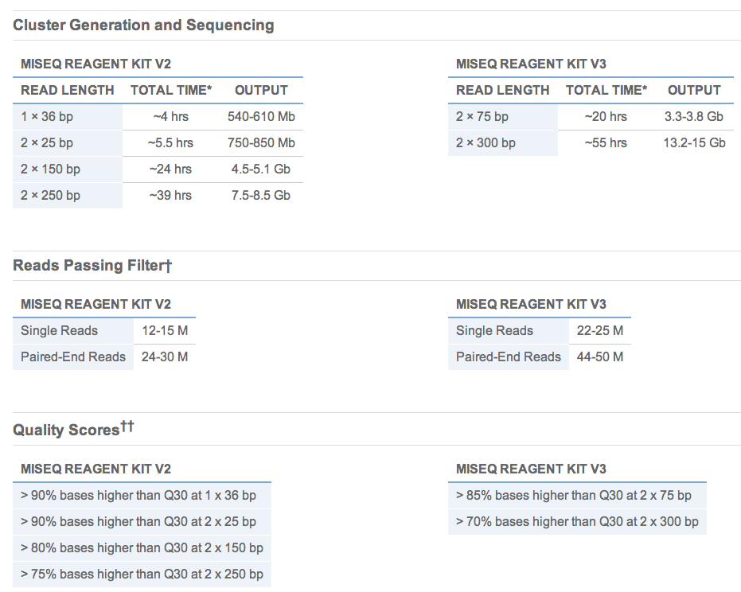
Instrument QC
MiSeq specifications

Slide 10
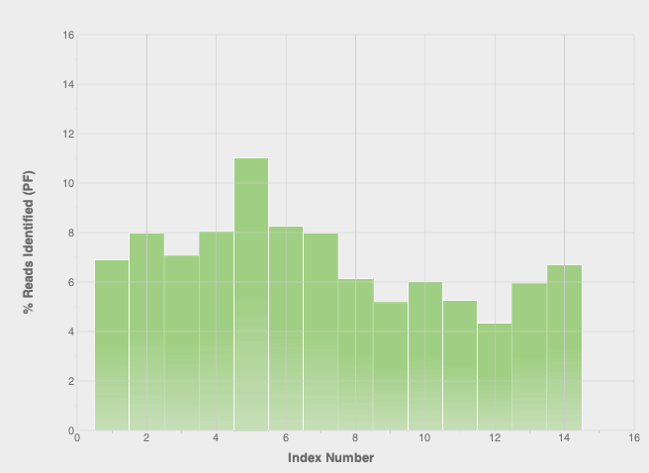
Instrument QC

Slide 11
FASTQ

Slide 12
FASTQ
@IL31_4368:1:1:996:8507/2
TCCCTTACCCCCAAGCTCCATACCCTCCTAATGCCCACACCTCTTACCTTAGGA
+
FFCEFFFEEFFFFFFFEFFEFFFEFCFC<EEFEFFFCEFF<;EEFF=FEE?FCE
@IL31_4368:1:1:996:21421/2
CAAAAACTTTCACTTTACCTGCCGGGTTTCCCAGTTTACATTCCACTGTTTGAC
+
>DBDDB,B9BAA4AAB7BB?7BBB=91;+*@;5<87+*=/*@@?9=73=.7)7*
@IL31_4368:1:1:997:10572/2
GATCTTCTGTGACTGGAAGAAAATGTGTTACATATTACATTTCTGTCCCCATTG
+
E?=EECE<EEEE98EEEEAEEBD??BE@AEAB><EEABCEEDEC<<EBDA=DEE
@IL31_4368:1:1:997:15684/2
CAGCCTCAGATTCAGCATTCTCAAATTCAGCTGCGGCTGAAACAGCAGCAGGAC
+
EEEEDEEE9EAEEDEEEEEEEEEECEEAAEEDEE<CD=D=*BCAC?;CB,<D@,
@IL31_4368:1:1:997:15249/2
AATGTTCTGAAACCTCTGAGAAAGCAAATATTTATTTTAATGAAAAATCCTTAT
+
EDEEC;EEE;EEE?EECE;7AEEEEEE07EECEA;D6D>+EE4E7EEE4;E=EA
@IL31_4368:1:1:997:6273/2
ACATTTACCAAGACCAAAGGAAACTTACCTTGCAAGAATTAGACAGTTCATTTG
+
EEAAFFFEEFEFCFAFFAFCCFFEFEF>EFFFFB?ABA@ECEE=<F@DE@DDF;
@IL31_4368:1:1:997:1657/2
CCCACCTCTCTCAATGTTTTCCATATGGCAGGGACTCAGCACAGGTGGATTAAT
(...)
Instrument serial #
Lane
Swath
X coord
Y coord
Read direction
Notes:
HWUSI-EAS100R the unique instrument name
6 flowcell lane
73 tile number within the flowcell lane
941 'x'-coordinate of the cluster within the tile
1973 'y'-coordinate of the cluster within the tile
#0 index number for a multiplexed sample (0 for no indexing)
/1 the member of a pair, /1 or /2 (paired-end or mate-pair reads only)

Slide 13
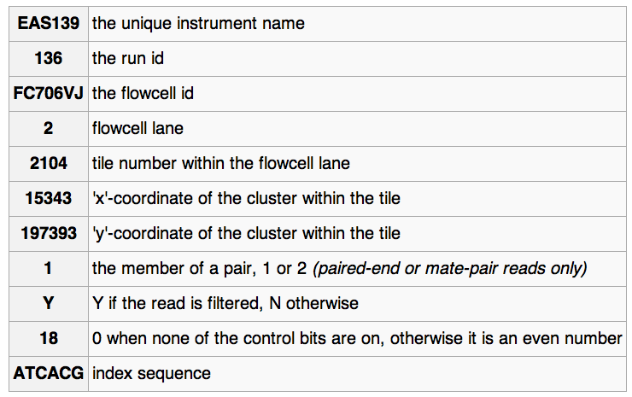
FASTQ read ID variations
@EAS139:136:FC706VJ:2:2104:15343:197393 1:Y:18:ATCACG

Slide 14
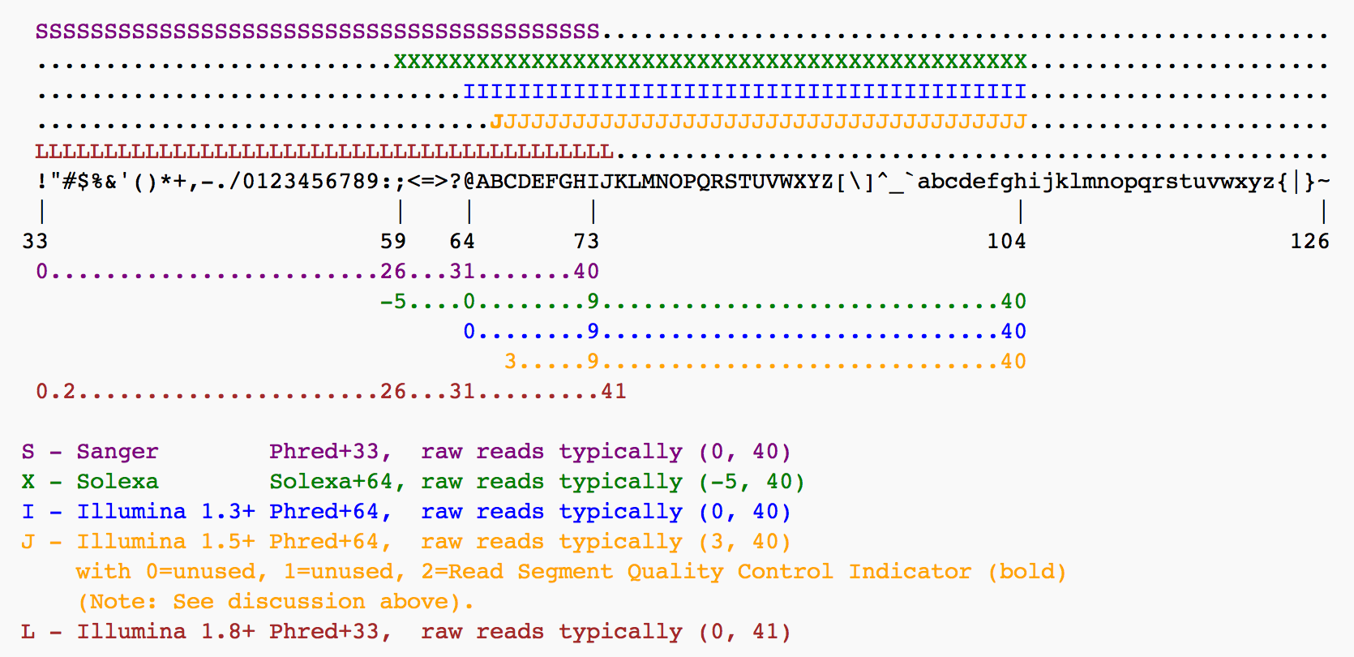
PHRED-like quality
Phred=-10log10(error)

Slide 15
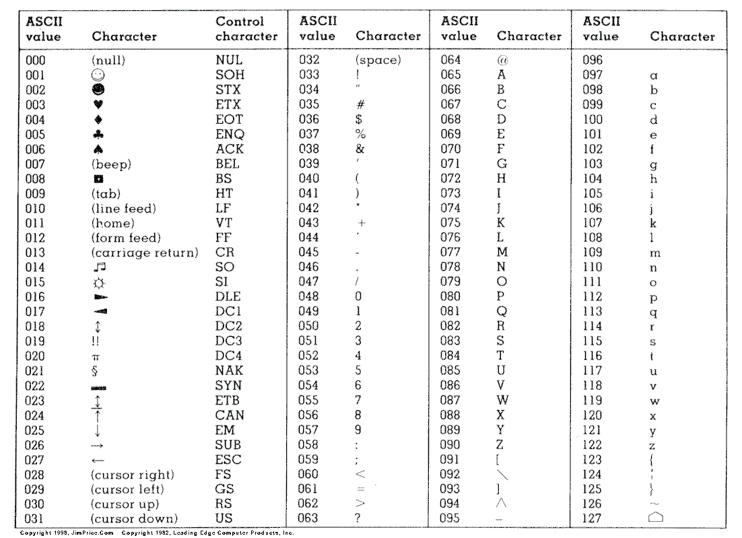
ASCII-Code

Slide 16
FASTQ QC

Slide 17
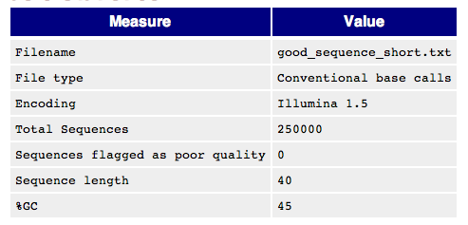
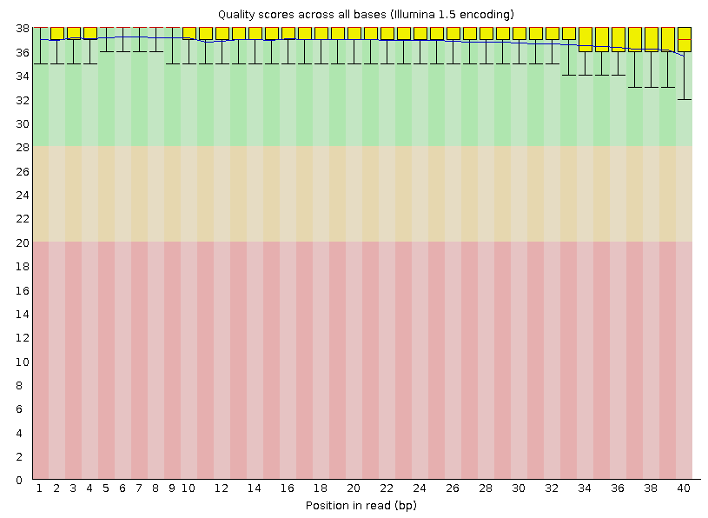
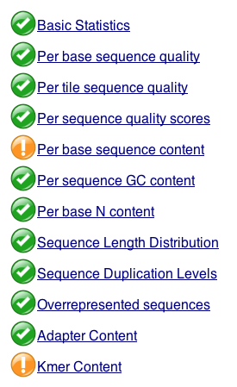
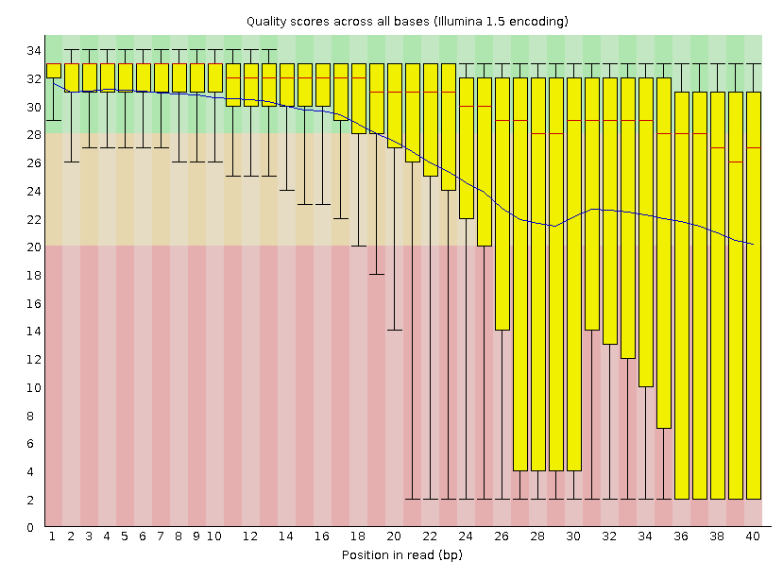
FASTQC
http://www.bioinformatics.babraham.ac.uk/projects/fastqc/

Slide 18
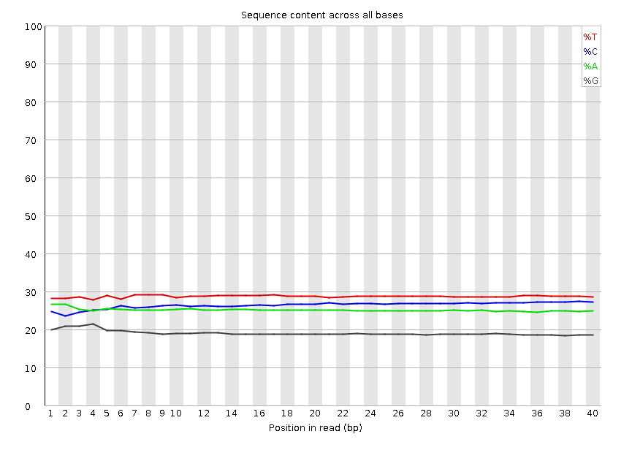
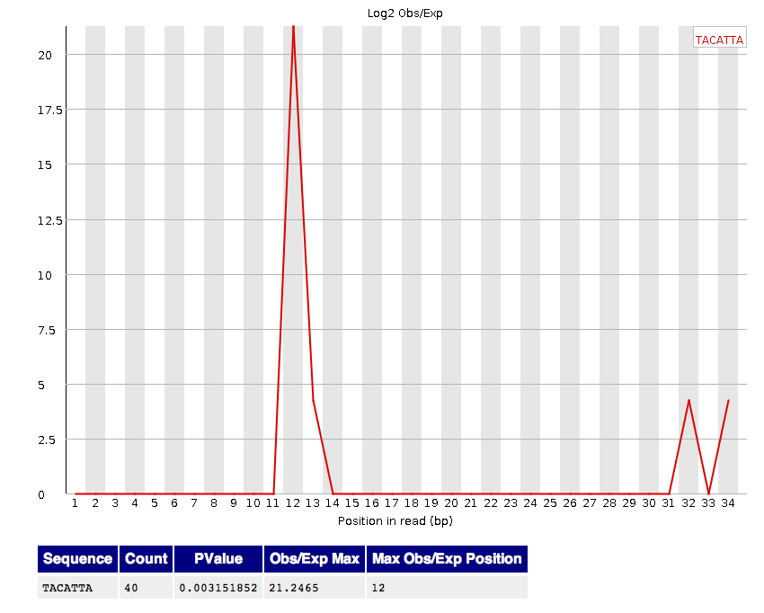
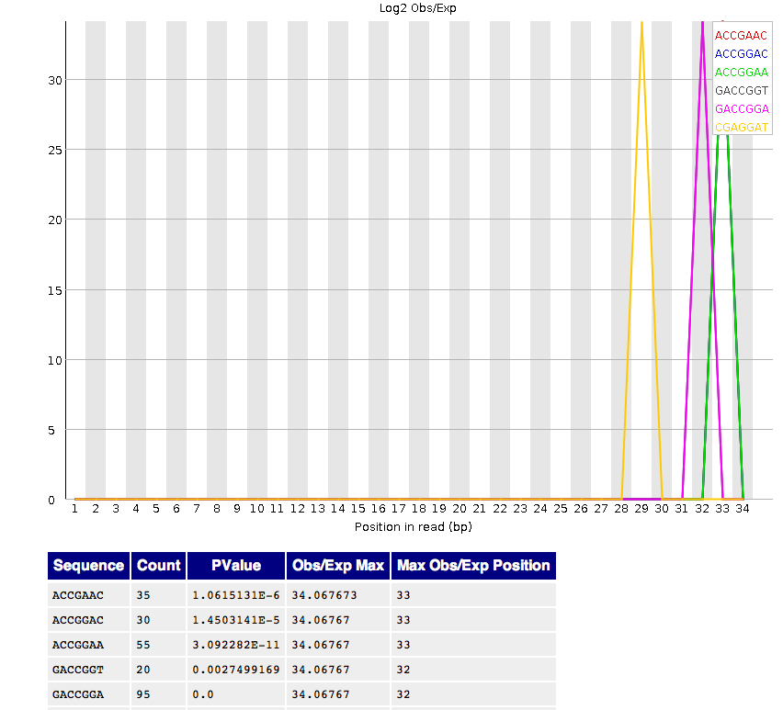
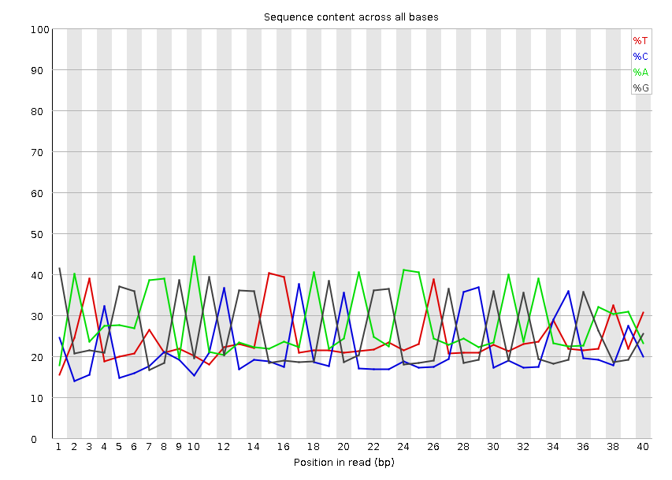
FASTQC Adapter Contamination

Slide 19
Alignment
Using BWA

Slide 20
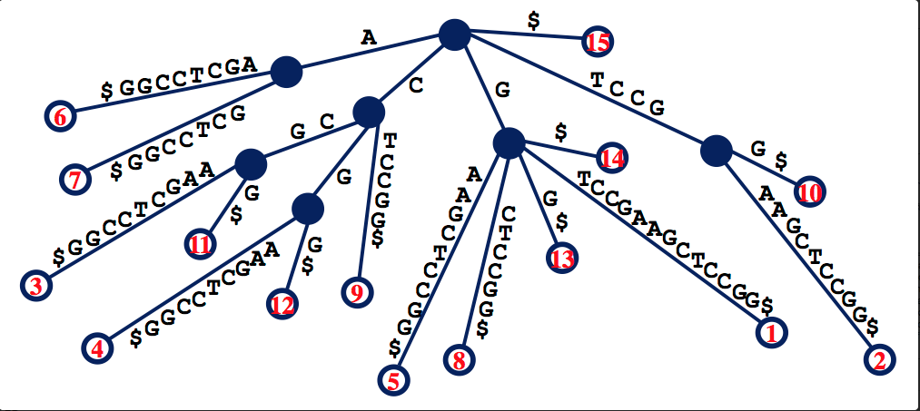
Suffix Array
GTCCGAAGCTCCGG$
Fast but too much memory requirement for the whole genome

Slide 21
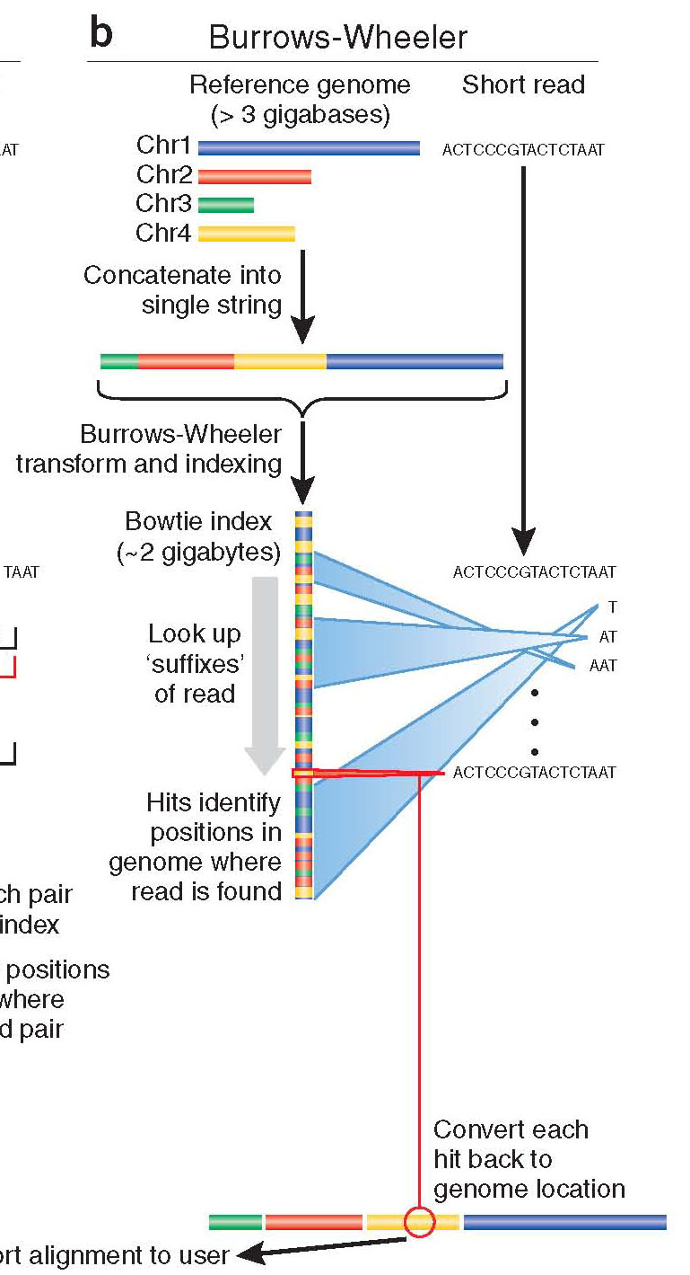
Burrows-Wheeler
Store entire reference genome.
Align tag base by base from the end.
When tag is traversed, all active locations are reported.
If no match is found, then back up and try a substitution.

Slide 22
Burrows-Wheeler Transform (BWT)
BWT
$acaacg
aacg$ac
acaacg$
acg$aca
caacg$a
cg$acaa
g$acaac
acaacg$
gc$aaac

Slide 23
Burrows-Wheeler Matrix
$acaacg
aacg$ac
acaacg$
acg$aca
caacg$a
cg$acaa
g$acaac

Slide 24
Burrows-Wheeler Matrix
3
1
4
2
5
6
$acaacg
aacg$ac
acaacg$
acg$aca
caacg$a
cg$acaa
g$acaac

Slide 25
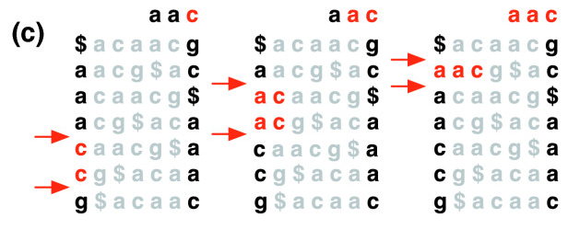
Burrows-Wheeler Transform
Langmead et al (2009)

Slide 26
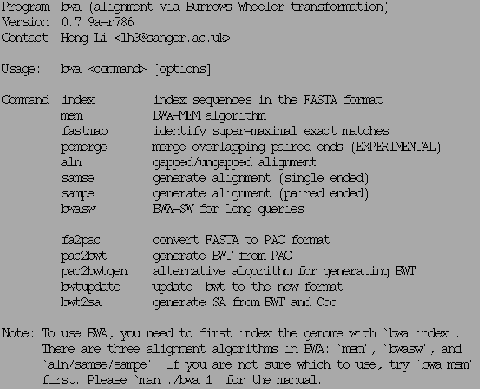
BWA

Slide 27
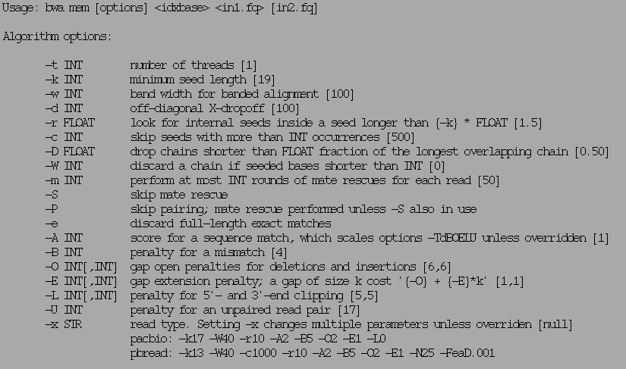
BWA mem

Slide 28
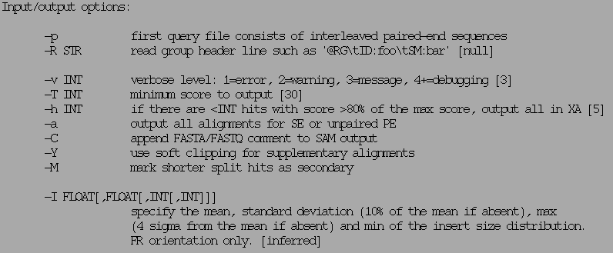
BWA mem

Slide 29
SAM/BAM format

Slide 30
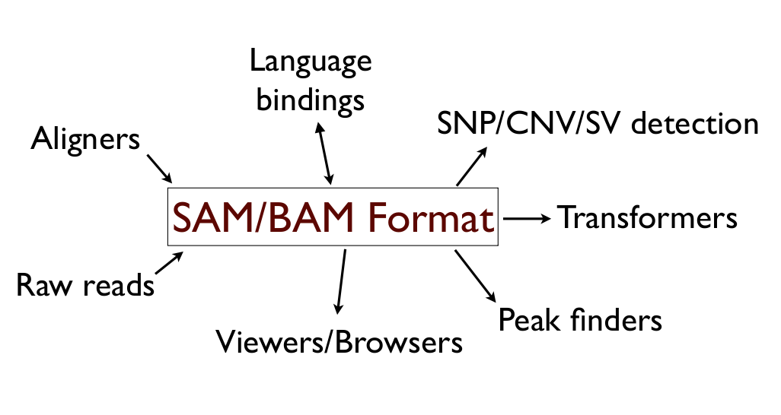
Utility

Slide 31
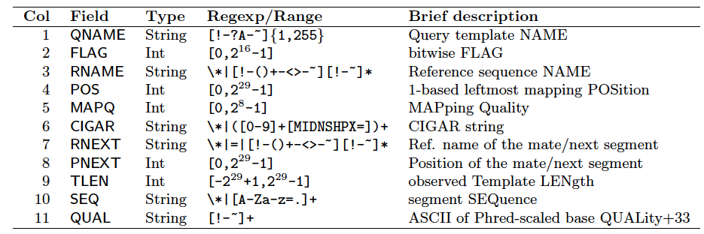
BAM format
Bioinformatics. 2009 Aug 15;25(16):2078-9. Epub 2009 Jun 8. The Sequence Alignment/Map format and SAMtools.

Slide 32
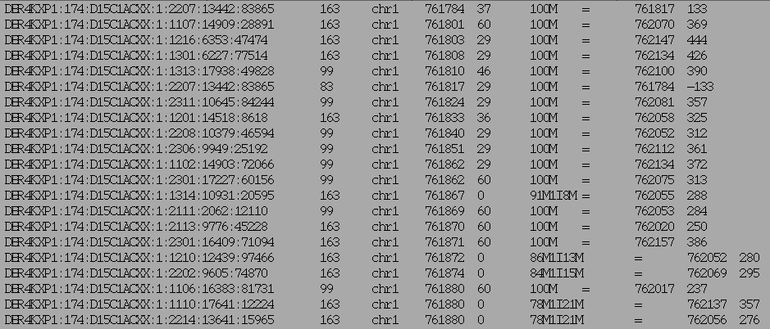
BAM example (field 1-9)

Slide 33
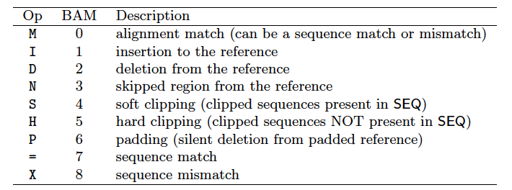
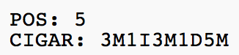
CIGAR string
Before alignment
After alignment

Slide 34
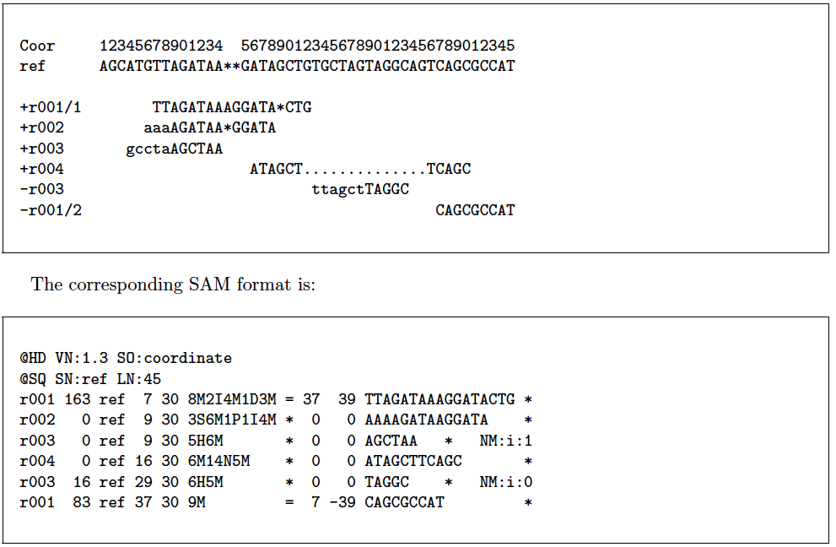
BAM example

Slide 35
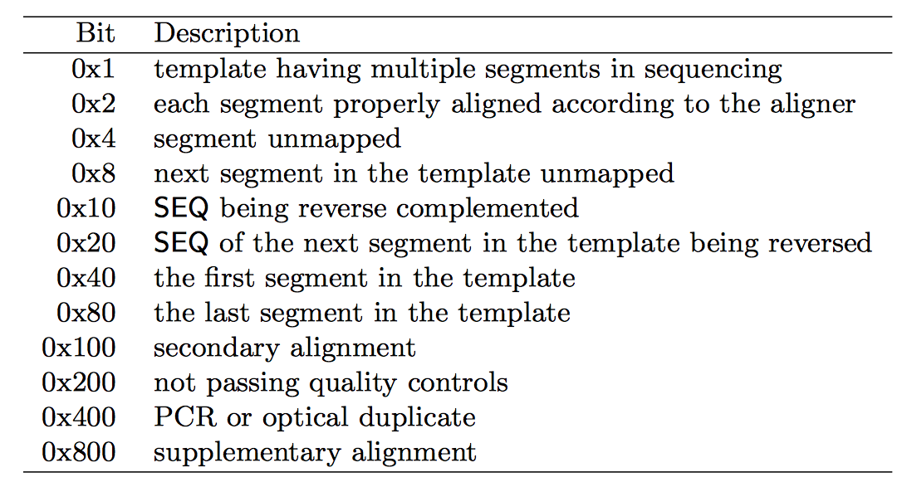
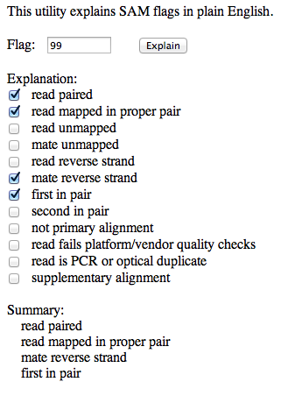
SAM FLAGS
http://picard.sourceforge.net/explain-flags.html

Slide 36
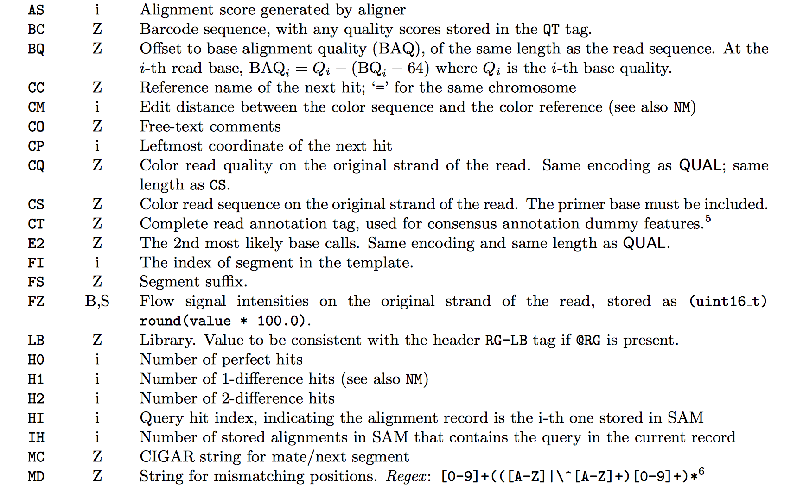
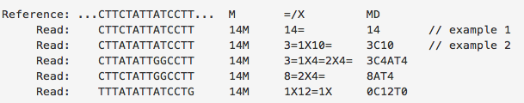
Extra Info (custom)

Slide 37
BAM/SAM format
flexible : compatible with multiple alignment programs
simple: easy to generate and convert
compact in file size
works on a stream : low memory footprint
Indexable for efficiency
SAM is human readable

Slide 38
SAMTOOLS & PICARD
SAM/BAM manipulation

Slide 39
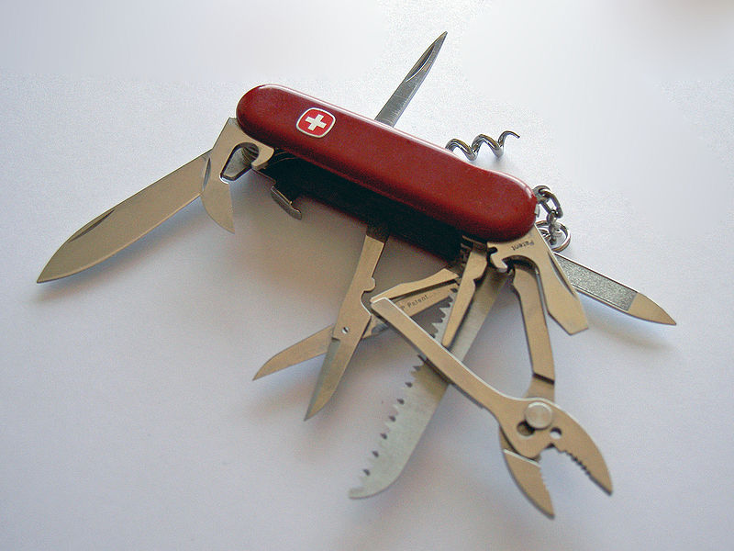

Slide 40
SAMTOOLS
Manipulate alignments in the BAM format
imports from and exports to the SAM (Sequence Alignment/Map) format
sorting
merging
indexing
retrieve reads in any regions
Works on a stream. Commands combined with Unix pipes.
Able to open a BAM on a remote FTP or HTTP server
http://www.htslib.org

Slide 41
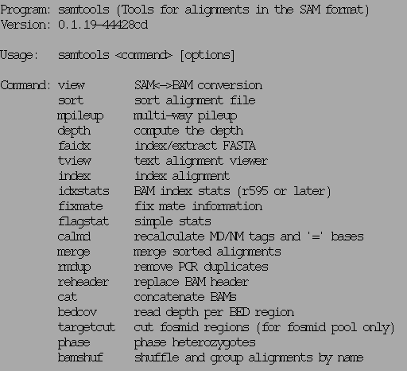
SAMTOOLS examples
http://www.htslib.org

Slide 42
SAMTOOLS view
Usage: samtools view [options] <in.bam>|<in.sam> [region1 [...]]
Options: -b output BAM
-h print header for the SAM output
-H print header only (no alignments)
-S input is SAM
-u uncompressed BAM output (force -b)
-1 fast compression (force -b)
-x output FLAG in HEX (samtools-C specific)
-X output FLAG in string (samtools-C specific)
-c print only the count of matching records
-B collapse the backward CIGAR operation
-@ INT number of BAM compression threads [0]
-L FILE output alignments overlapping the input BED FILE [null]
-t FILE list of reference names and lengths (force -S) [null]
-T FILE reference sequence file (force -S) [null]
-o FILE output file name [stdout]
-R FILE list of read groups to be outputted [null]
-f INT required flag, 0 for unset [0]
-F INT filtering flag, 0 for unset [0]
-q INT minimum mapping quality [0]
-l STR only output reads in library STR [null]
-r STR only output reads in read group STR [null]
-s FLOAT fraction of templates to subsample; integer part as seed [-1]
-? longer help
http://www.htslib.org

Slide 43
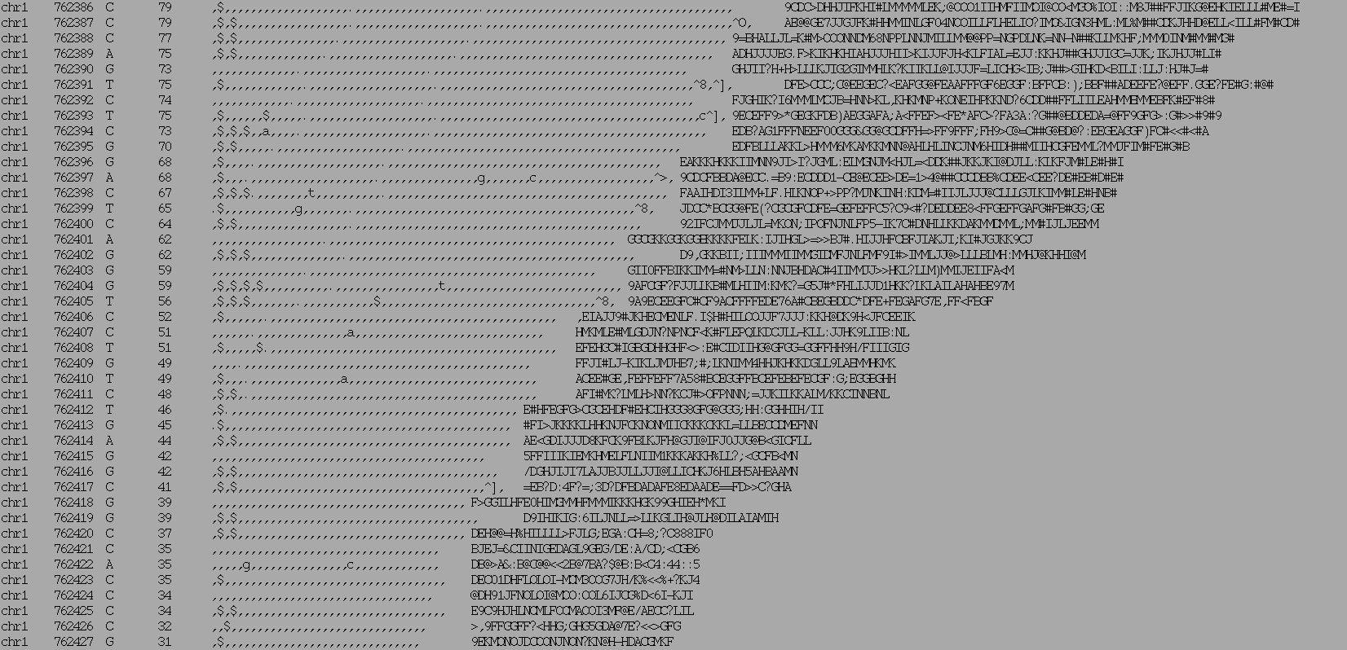
SAMTOOLS Pileup
Chrom
Ref
Read bases
Qualities
Position
Coverage

Slide 44
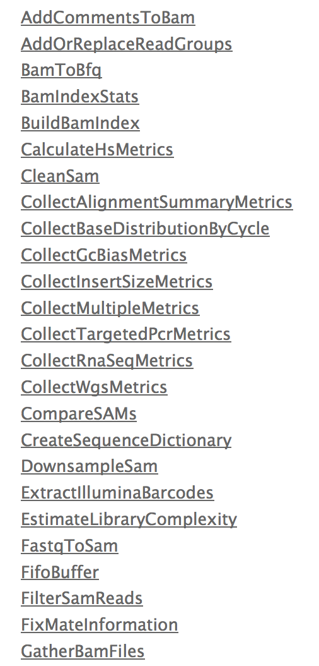
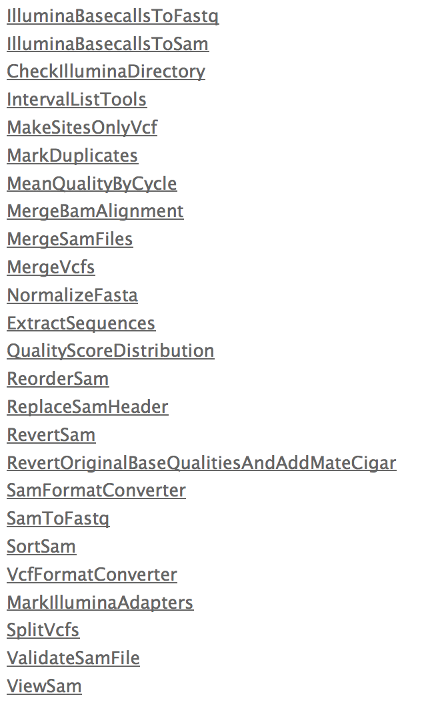
Picard – the other tool box
http://picard.sourceforge.net/

Slide 45
BED and BEDTOOLS
Interval Manipulation

Slide 46
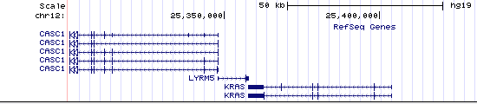
BED track

Slide 47
BED format
Header (space separated) [optional]
Chr [mandatory]
Start [mandatory]
Stop [mandatory]
Other (optional)
Name
Strand
Color
Type
A BAM alignment can be condensed into a BED file: Information loss !

Slide 48
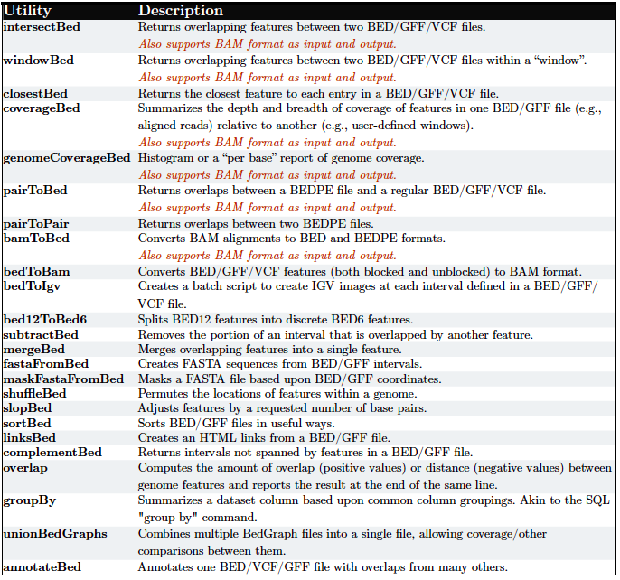
BEDTOOLS

Slide 49
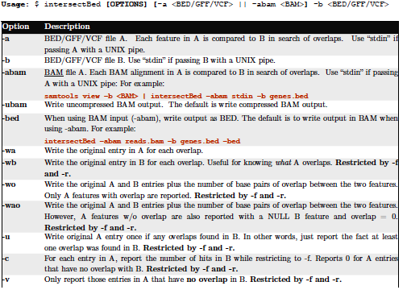
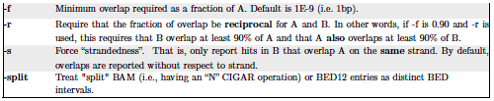
IntersectBed

Slide 50
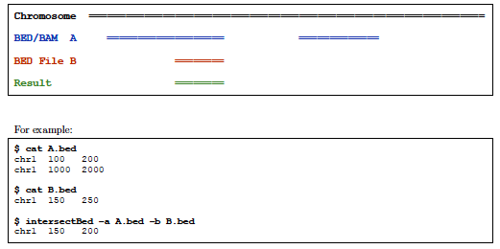
Intersect BED

Slide 51
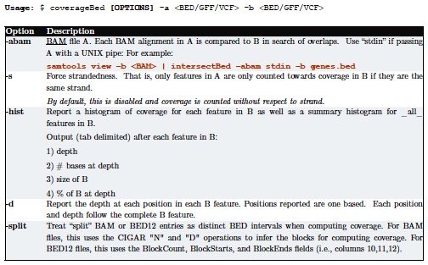
coverageBed

Slide 52
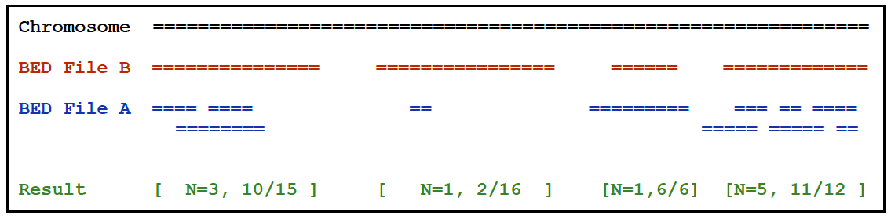
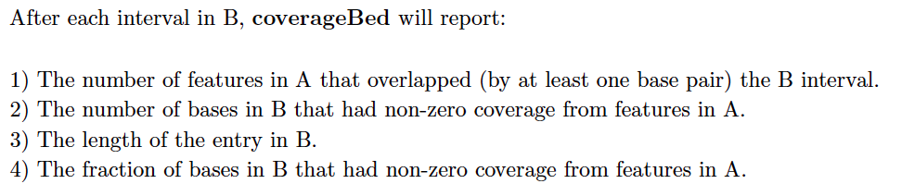
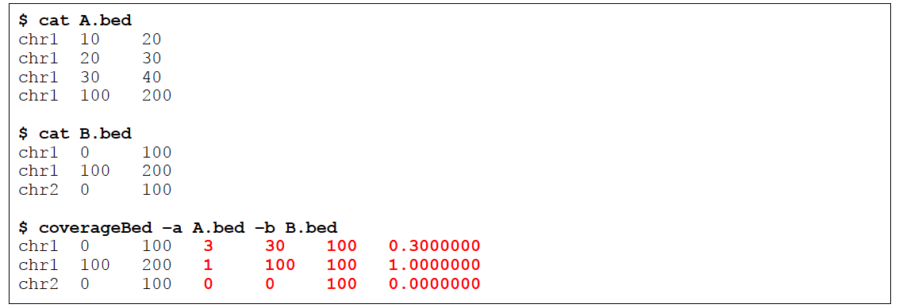
coverageBed

Slide 53
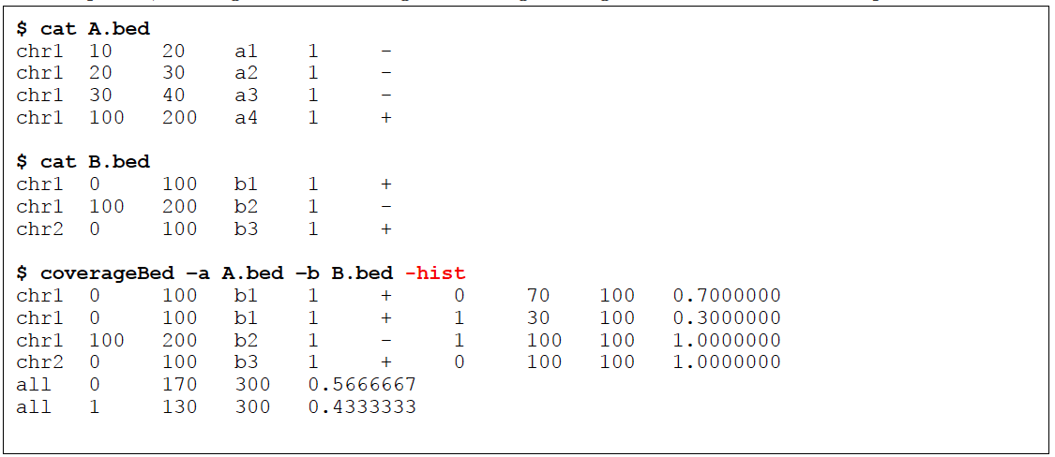
coverageBed

Slide 54
GATK
BAM postprocessing

Slide 55
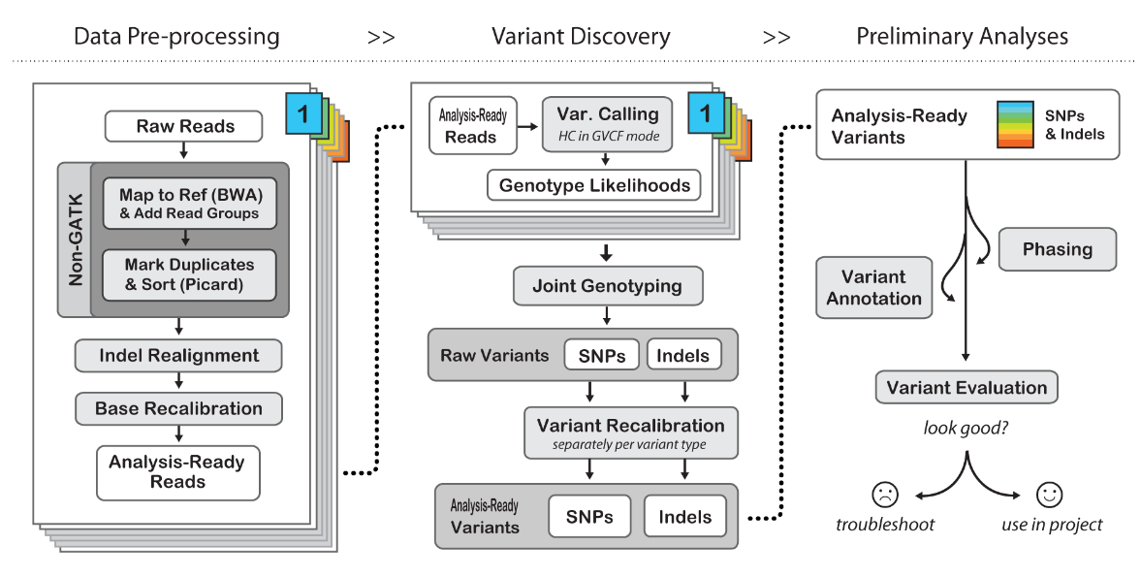
GATK Best Practice

Slide 56
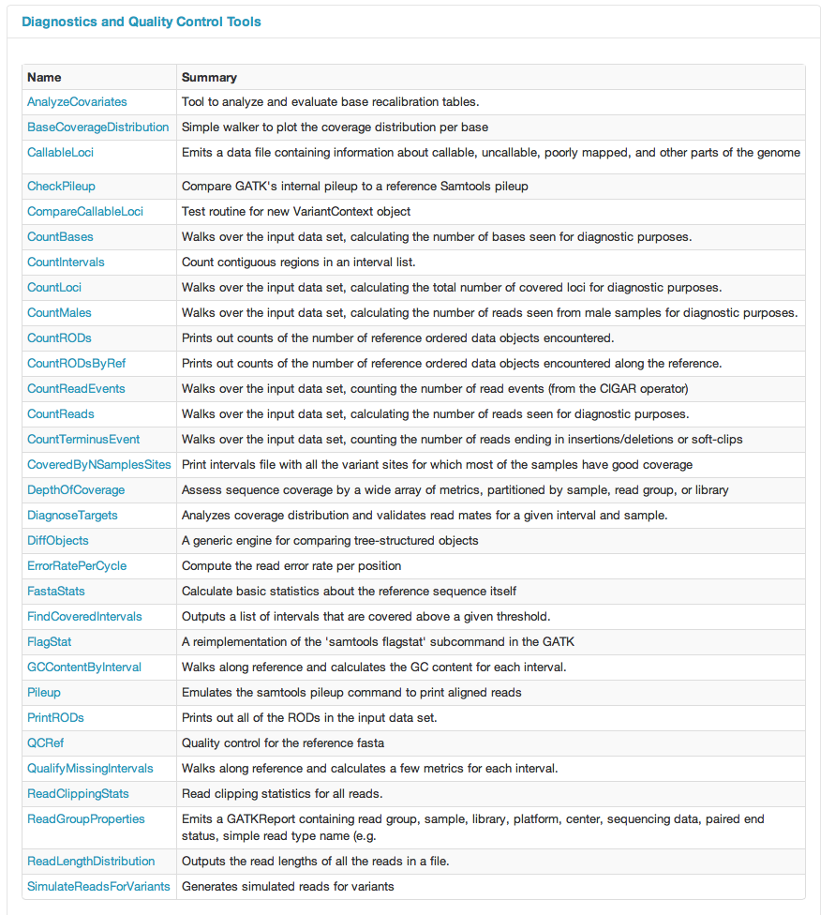

Slide 57


Slide 58


Slide 59


Slide 60


Slide 61


Slide 62

INDEL Realignment
The problem

Slide 63

INDEL Realignment
The problem

Slide 64

INDEL Realignment
The solution

Slide 65



Base Quality Recalibration
DePristo et al (2011)

Slide 66
ALIGNMENT VISUALISATION

Slide 67

Integrative Genome Viewer
http://www.broadinstitute.org/software/igv/

Slide 68
Integrative Genome Viewer
http://www.broadinstitute.org/software/igv/

Slide 69
Variant Calling
GATK/VARSCAN

Slide 70
Variant Calling
Bayesian Statistics
P(genotype|data)  P(data|genotype).P(genotype)
P(genotype) : prior probability for the genotype
P(data|genotype): likelihood for observed (called) allele
Likelihood P(data|genotype): What’s known to affect base calling:
• Error rate increases as cycle numbers increase
• Error rate depends on substitution type
• Error rate depends on local sequence

Slide 71

GATK Callers

Slide 72

Somatic Variant Calling
Compare Normal and Tumor directly
Results
Germline: Present in both
Somatic: Present in Tumor only
Loss of Heterozygosity: Missed Het in the tumor
Fisher Exact test
Kobolt et al. (2012)

Slide 73

Heuristic Filters

Slide 74
Variant ANALYSIS
VCF / VCFTOOLS

Slide 75

VCF format

Slide 76

VCF format

Slide 77

VCFLib

Slide 78

VCFLib

Slide 79

VCFLib

Slide 80
Variant ANNOTATION

Slide 81
Variant Annotation Tools
SNPEff (Broad)
http://snpeff.sourceforge.net
VEP (Sanger)
http://www.ensembl.org/info/docs/tools/vep/index.html
ANNOVAR
http://www.openbioinformatics.org/annovar/
Variant Tools (database / Manipulation)
http://varianttools.sourceforge.net
McCarty et al: http://genomemedicine.com/content/6/3/26

Slide 82


ANNOVAR
exonic_variant_functoin

Slide 83

McCarty et al: http://genomemedicine.com/content/6/3/26

Slide 84

Annotation Challenges
Compensating mutations
DNP or TNP need to be annotated together
Phase of Indels on the same haplotype
Partial effects
Mutation affecting one transcript only
Same gene
Unknown Loss of Function mutations affecting known cancer genes
Adapted from MacArthur et al, 2012

Slide 85
Useful Annotations
dbSNP
dbNSFP
SIFT
MutationTaster
COSMIC
ESP data
1000G data
ExAC

Slide 86

Variant Effect Prediction
SIFT
Ng et al

Slide 87
Summary and Resources
Formats
FASTQ
SAM/BAM (CRAM)
VCF
Alignment and tools
BWA
IGV
Samtools
Post-Alignment Processing and QC
GATK IndelRealigner
GATK BaseRecalibrator
Picard MarkDuplicate
Picard HS-Metrics
Samtools
Variant Calling
GATK UnifiedGenotyper
GATK HaplotypeCaller
FreeBayes
VarScan (somatic)
Mutect (somatic)
Variant Annotations
SNPEff
ANNOVAR
Vtools
VEP

Slide 88
Other Resources/Tools
BaseSpace: the illumina app store
https://basespace.illumina.com
cBioportal: A repository of cancer genomics data
http://www.cbioportal.org
UCSC Cancer Genomic: A repository/browser of cancer genomics data
https://genome-cancer.ucsc.edu
MAGI: A tool for Mutation Annotation and Genomic Interpretation
http://magi.cs.brown.edu

